Slide 1
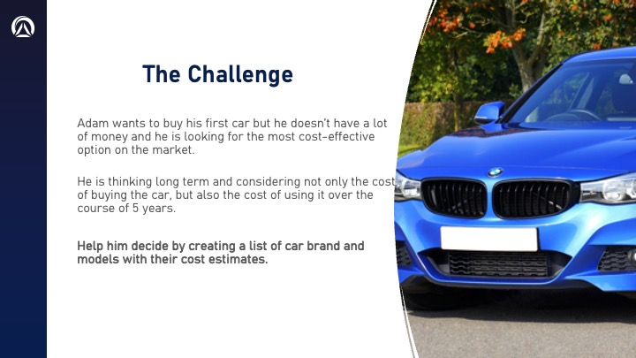
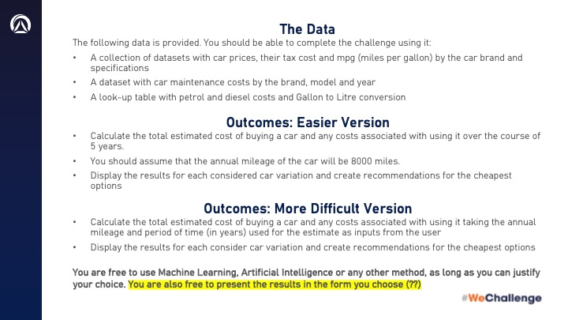
Introduction

Slide 2
Goal
Objective: To help users find the most cost-effective car option considering purchase price and long-term use.
Approach: Developing a ML model to estimate total costs based on user input (annual mileage, ownership period).

Slide 3
Impact
informed decision-making for budget-conscious buyers like Adam
Assists in understanding long-term financial implications of car ownership

Slide 4
Challenges
Feature engineering the dataset on inbalanced dataset
Ensuring the model reliably predicts for all possible costs

Slide 5
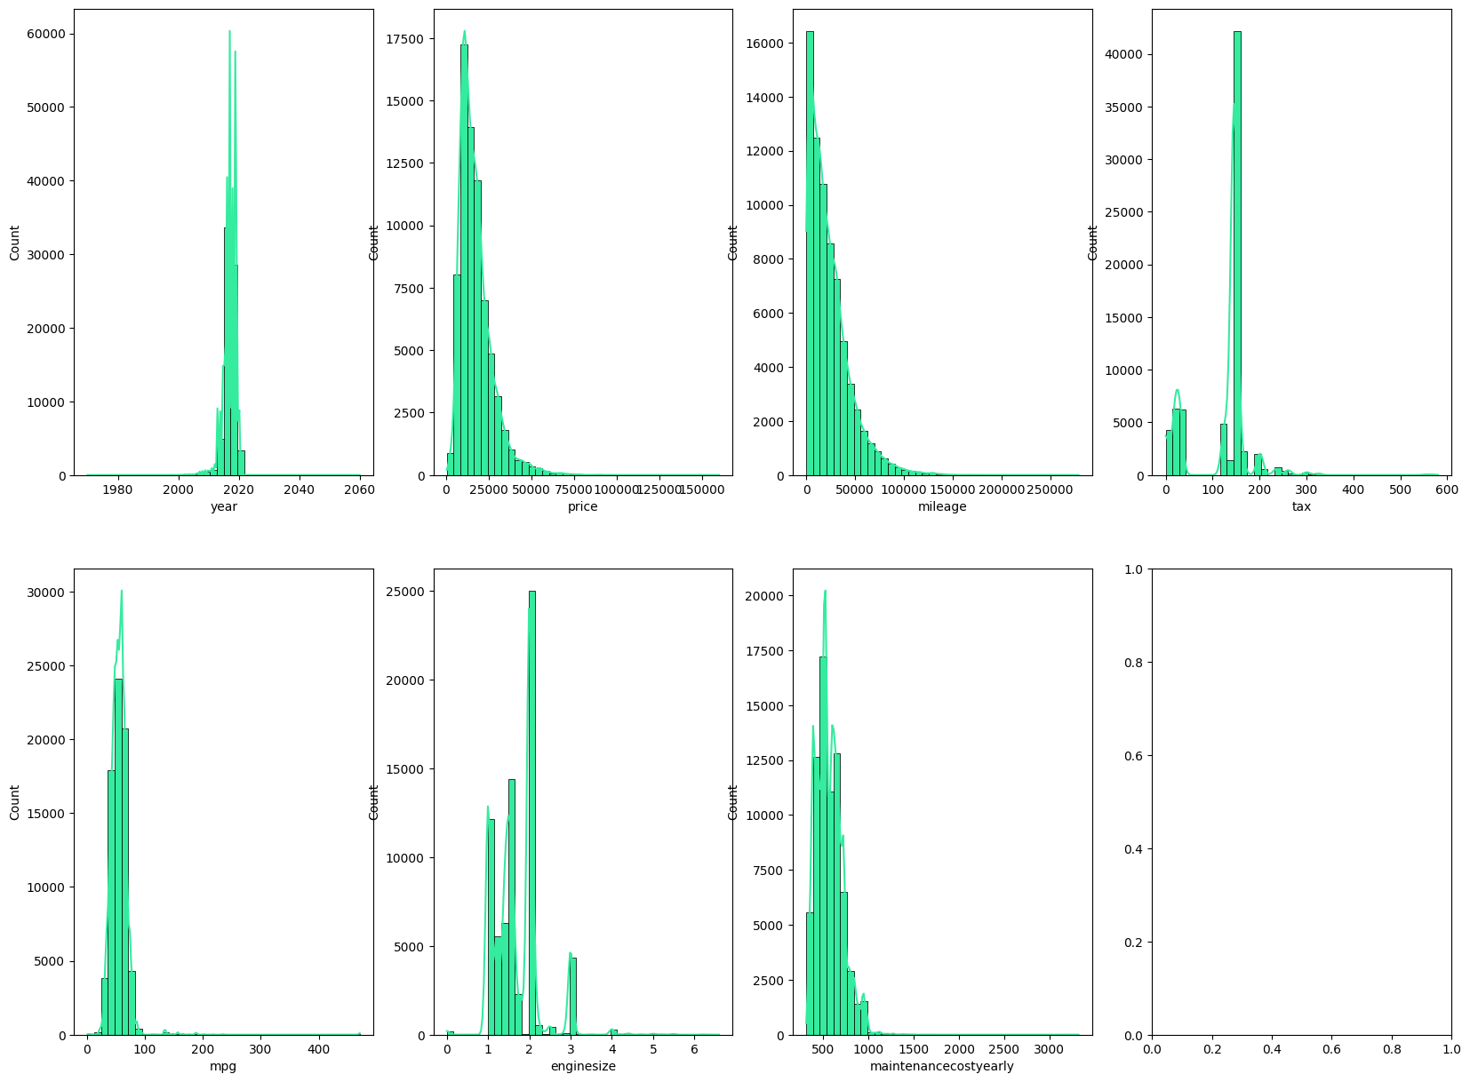
Interesting Findings
Insights:
New car models
Affordability annually
For stakeholder :
inventory

Slide 6
Machine Learning Models
RandomForest regressor

Slide 7
Conclusion
In summary, our project provides a valuable tool for those seeking financial prudence in car ownership. Looking forward, we are exploring ways to make the dataset with less outliers & refine our model further .

